Slide 1
Book Corners
Over the next four weeks, Witham St Hughs English Hub will be sharing the importance of building the best book corners in Reception & KS1.
This week we will be looking at ...
getting the right books.
‘Emotional engagement is the tipping point between leaping into the reading life or remaining in a childhood bog where reading is endured only as a means to other ends.’​
Maryanne Wolf
Choose books that are going to engage with children, both emotionally or intellectually, those that:
elicit a response – excitement, interest, anger, curiosity
have a strong narrative structure and intriguing illustrations
extend vocabulary
connect with something the children already know.

Slide 2
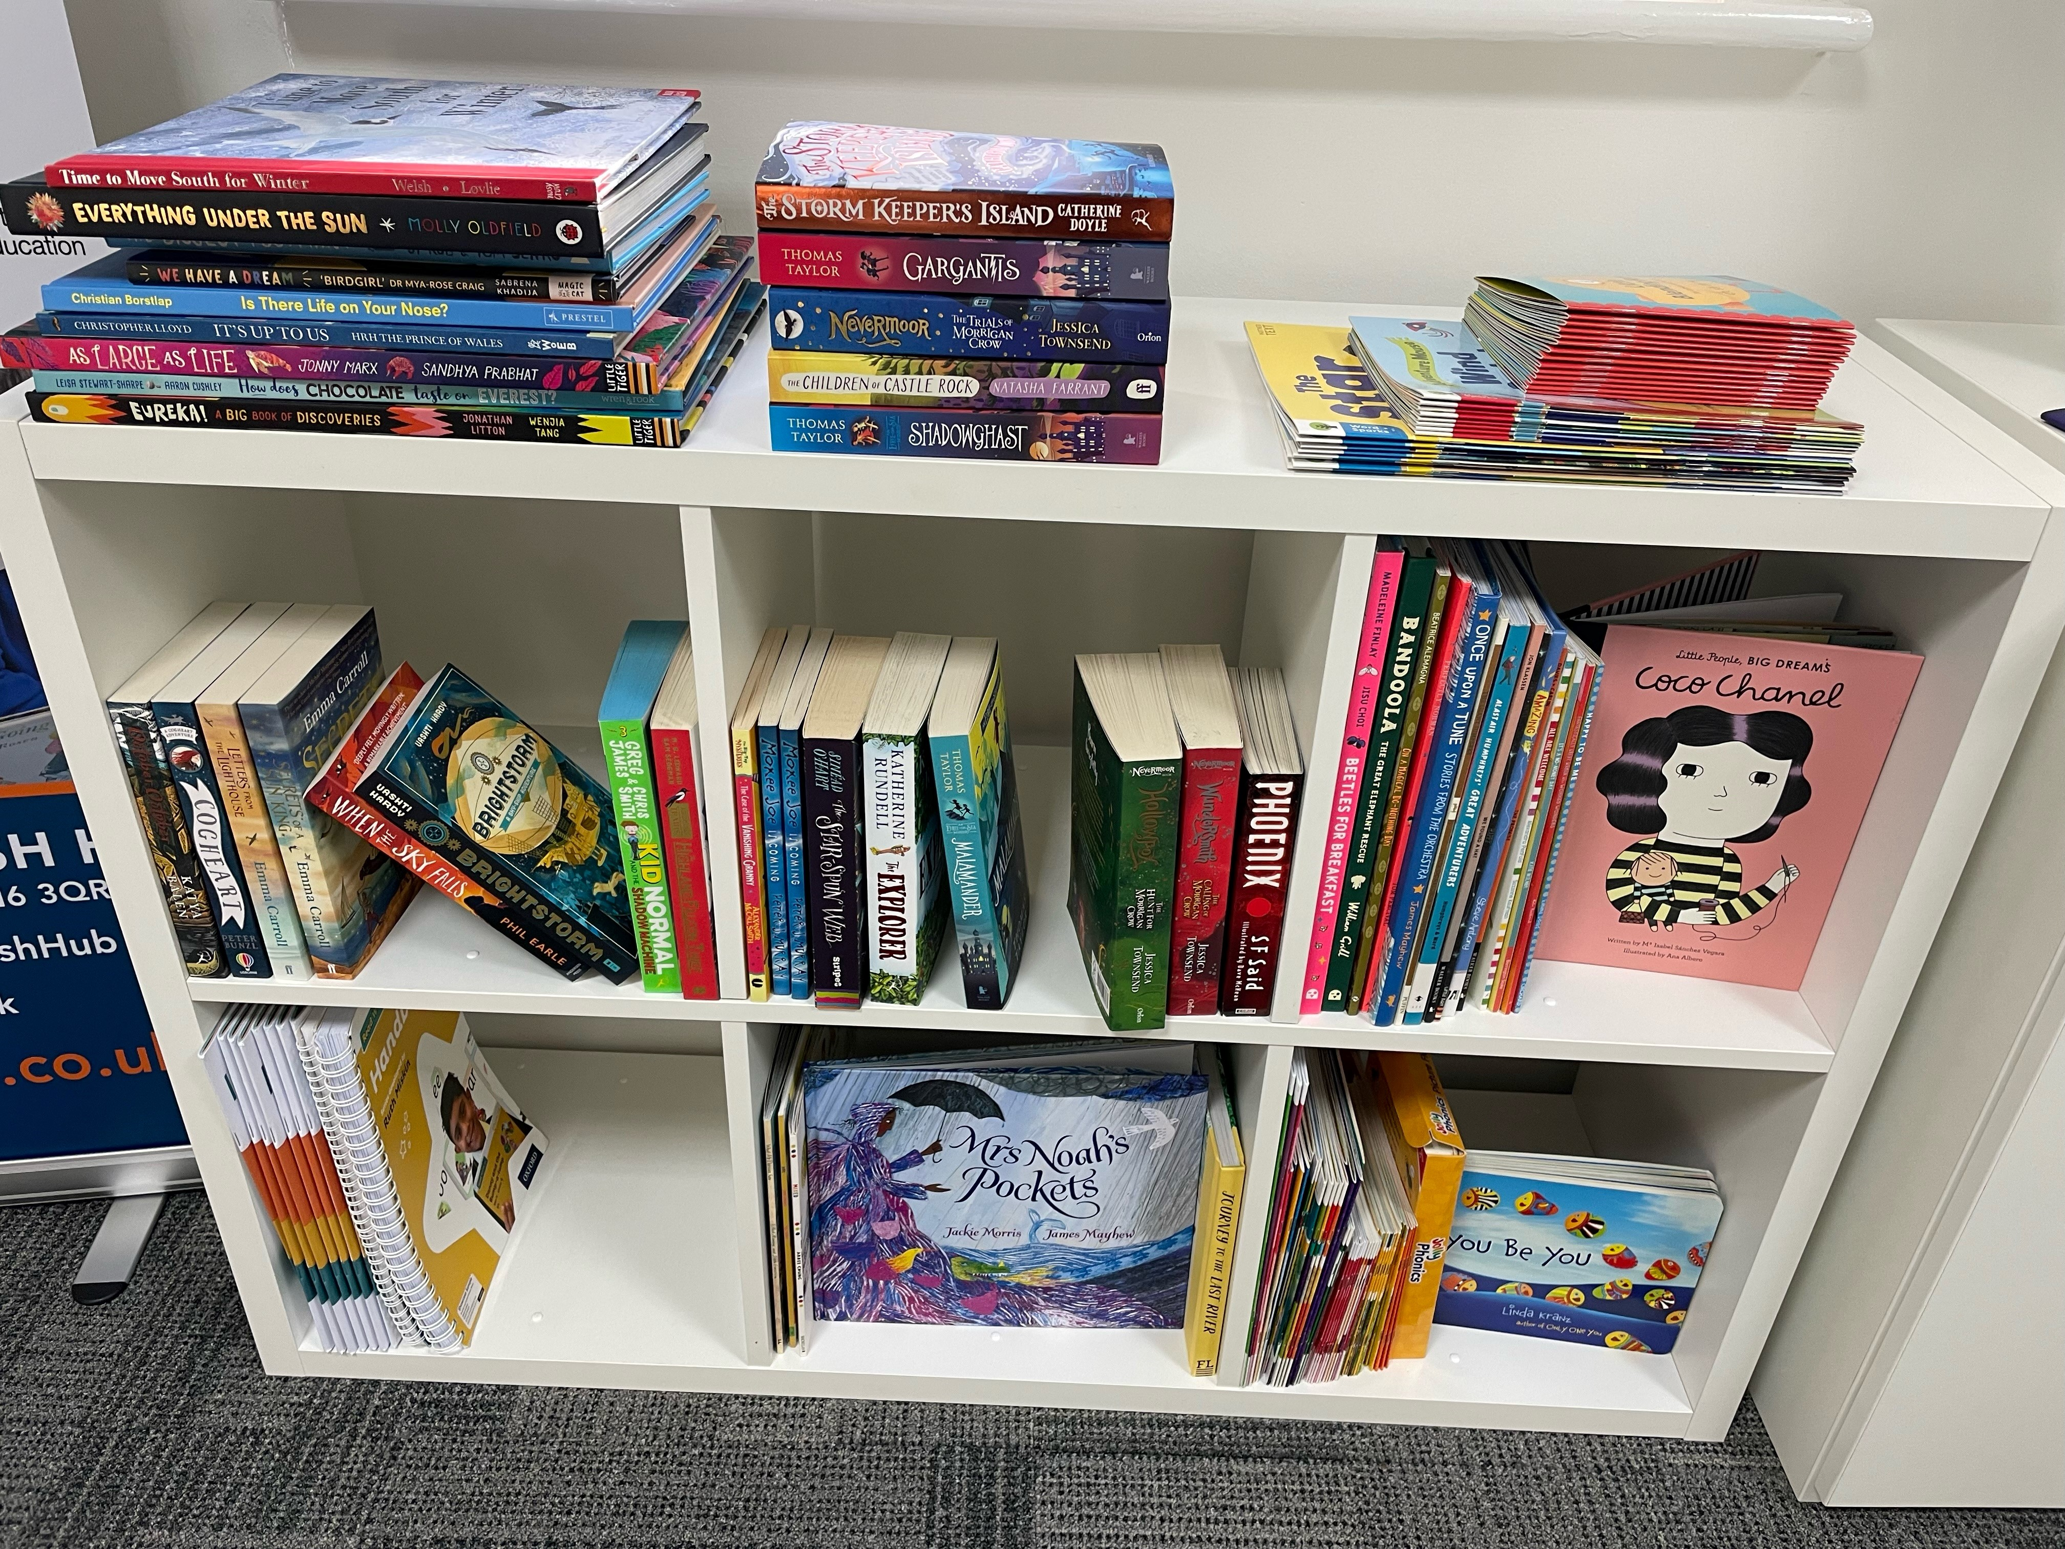
Book Corners
Each week, Witham St Hughs English Hub will be sharing the importance of building the best book corners in Reception & KS1.
This week we will be looking at...
selecting and sorting the books.
Start by taking out all the decodable books for your phonics programme and store them in a separate area.
Collect ALL the remaining books from classrooms, the library, book corners and school bookshelves and put them all in one place.
3. Sort these books into:
A keep pile – these are quality picture books, series of books and non-fiction books.
A ‘Room 101’ pile – books you would not want to read aloud to children, tired, worn books and non-phonic reading scheme books.
A ‘not sure’ pile – this pile will need a small group of teachers to decide together what to do with these.

Slide 3
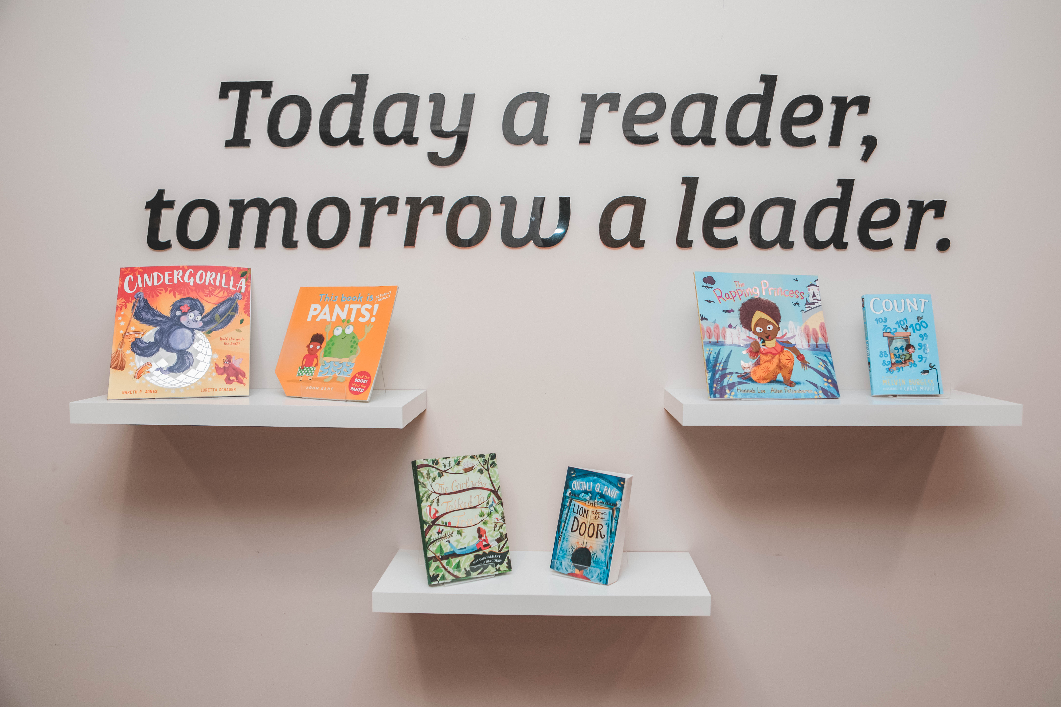
Book Corners
Each week, Witham St Hughs English Hub will be sharing the importance of building the best book corners in Reception & KS1.
This week we will be looking at...
organising books.
Organise the books in alphabetical order in broad age-ranges:
Picture books for 4–5-year-olds
Picture books for 5–7-year-olds
Series of books for 6–7-year-olds
Non-fiction for 5-7 year-olds
This becomes a great ‘bookshop’ (the central library!) for all Reception, Year 1 and Year 2 teachers to select books for their class libraries.
Let the books do the talking!

Slide 4
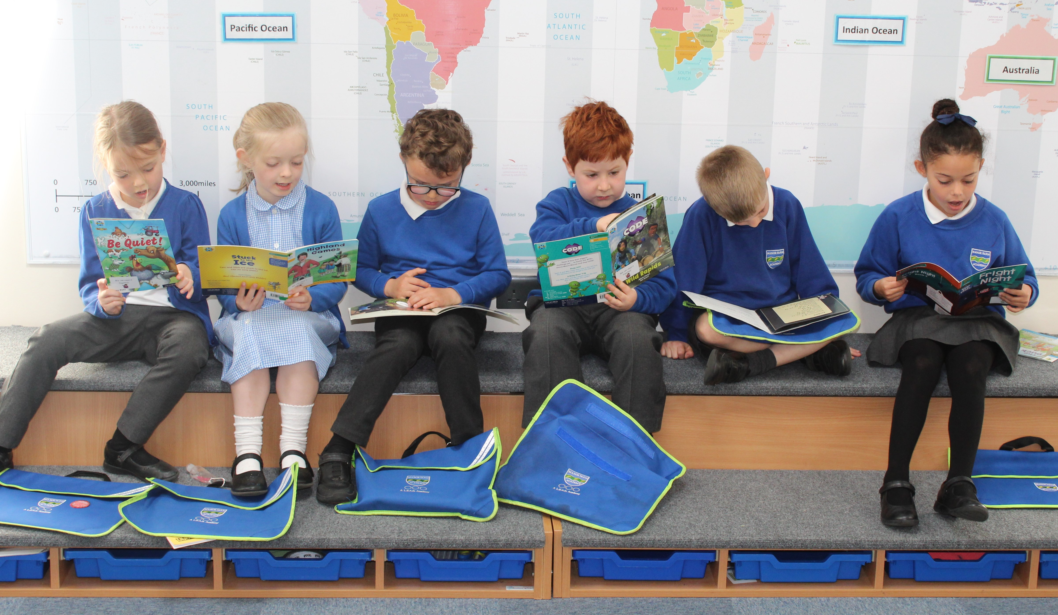
Book Corners
Each week, Witham St Hughs English Hub will be sharing the importance of building the best book corners in Reception & KS1.
This week we will be looking at...
choosing the right books for your R, Y1 & Y2 class libraries.
Start by selecting 30-40 books. You could include 20 favourites from the previous year, if starting in September.
These books will be for all the children in the class. Some children will only be able to retell the story; others will be able to re-read it for themselves.
Gradually introduce more books, week by week.
Take out other books as the year progresses. Involve the children in returning some books to the whole school library.

