Slide 1

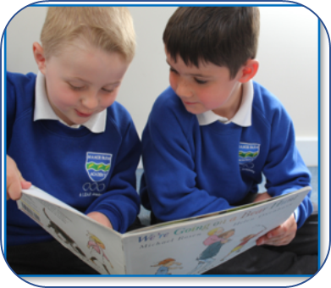
S.A.L.E.S
Over the next six weeks, Witham St Hughs English Hub will be sharing ideas on how to increase children’s love of reading using the S.A.L.E.S strategies.
STRATEGIES TO INCREASE CHILDREN’S LOVE OF READING ​
​
S is for – Same – Persuade children that they all want to be reading the same thing. ​
A is for – Authority – Become an expert on children’s books. ​
L is for – Live it – Breathe life into the book. ​
E is for – Ease – Make it easy for children to find books. ​
S is also for – Scarcity - Make the book desirable by suggesting copies of it are in short supply.

Slide 2
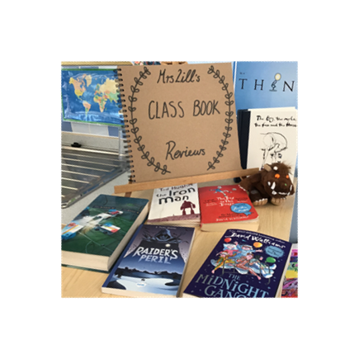
S.A.L.E.S
Each week Witham St Hughs English Hub will be sharing ideas on how to increase children’s love of reading using the S.A.L.E.S strategies.
This week we will be looking into S - Same
Persuade children that they all want to be reading the same thing. ​
ACTIONS
Know what your children like reading. ​
Know children’s interests and the books they like. ​
Set up book clubs, where children can recommend books to each other. ​
Set up the children’s own notice board where they can post their own notes about books and photos of themselves reading.

Slide 3
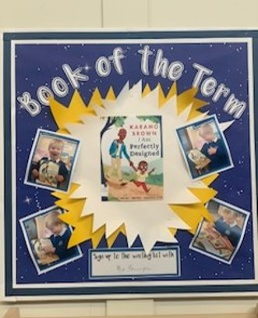
S.A.L.E.S
Each week Witham St Hughs English Hub will be sharing ideas on how to increase children’s love of reading using the S.A.L.E.S strategies.
This week we will be looking into A - Authority
Become an expert on children’s books. ​
ACTIONS
Become an expert on children’s books. ​
Recommend books with similar themes, settings and characters: ‘If you like this book…you might also like this…’. ​
Find series of books by the same author or illustrator. ​
Promote other teachers’ and the headteacher’s suggestions. ​
Invite authors to recommend books. ​
Display ‘Author of the week/month’. ​
Encourage children from older classes to recommend books. ​
Use a website of authors.

Slide 4

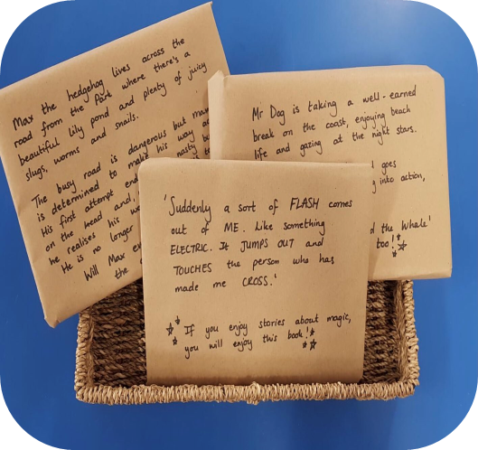
S.A.L.E.S
Each week Witham St Hughs English Hub will be sharing ideas on how to increase children’s love of reading using the S.A.L.E.S strategies.
This week we will be looking into L - Live It
Breathe life into the book.
ACTIONS
Breathe life into the book. ​
Find a ‘hook’ to inspire the children. ​
Give clues about the new book you’ll read later - reveal them gradually throughout the day. ​
Arrange for the new class book to be delivered via the post - wrap and then unwrap the new book to introduce to the children. ​
Ask secret readers (a member of staff or a parent) to read the class a story.​
Stop reading on a cliff-hanger.

Slide 5
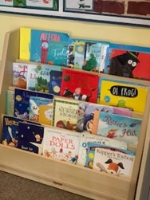
S.A.L.E.S
Each week Witham St Hughs English Hub will be sharing ideas on how to increase children’s love of reading using the S.A.L.E.S strategies.
This week we will be looking into E- Ease
Make it easy for children to find books.
ACTIONS
Make it easy for children to find books - remember the brain can only cope with a few choices. ​
Ensure your book area is decluttered so that it is easier for children to find books. ​
Display a few books on a table or in an interesting basket. ​
Display books linked to your topic. ​
Display the teacher’s own reading selection in a story suitcase. ​
Let parents know which books you are reading in class. ​
Have ‘golden book bags’; one child each week receives a book especially selected for them. ​
Use consistent routines for choosing and changing books.

Slide 6
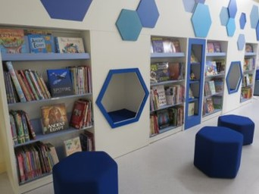
S.A.L.E.S
For the final week, Witham St Hughs English Hub will be sharing this last S.A.L.E.S strategy on how to increase children’s love of reading.
This week we will be looking into S - Scarcity
Make the book desirable by suggesting copies of it are in short supply.​
ACTIONS
Make the book desirable by suggesting copies of it are in short supply. ​
Don’t clutter the book area! ​
Read a teaser from the book but release the book at a later date. ​
‘Read it before it’s gone’; have some books available for a limited period. ​
Have limited copies and get children to sign up for a book. ​
Offer alternatives by the same author whilst children wait for a specific book. ​
Create a ‘pop up’ library in an area of the school for a limited time. ​
Bring in a ‘special’ book from home that you will lend if children promise to read it within a limited time.

