Slide 1




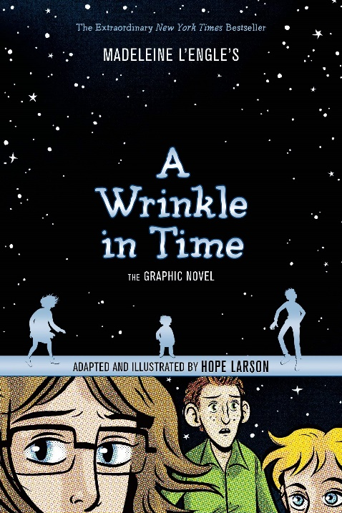




Graphic Novels Book List

